Slide 1
Shop for home CAPSTONE PROJECT
Presented by:
Lakshmi Vineetha
Bhavya Kancharla
Sumanth
Mahima
Daneswari Aketi
Mentor: Praveen Tej

Slide 2
Objectives
1. Create git repository
2. Create database schema (all tables along with their relationships)
3. Create entities in Spring
4. Create Microservice based structure.
5. CRUD on User and Products
6. Create an e-commerce Template in Angular (Static only) to hold images and products lists.
7. Develop Search Functionality in Angular
8.Bulk upload implementation

Slide 3
User Stories:
1.As a user I should be able to login, Logout and Register into the application.
2.As a user I should be able to see the products in different categories.
3.As a user I should be able to sort the products.
4.As a user I should be able to add the products into the shopping cart.
5.As a user I should be able to increase or decrease the quantity added in the cart.
6.As a user I should be able to add “n” number of products in the cart.
7.As a user I should be able to get the Wishlist option where I can add those products which I want but don’t want to order now.
8.As a user I should get different discount coupons.
Admin Stories –
1.As an Admin I should be able to login, Logout and Register into the application.
2.As an Admin I should be able to perform CRUD on Users.
3.As an Admin I should be able to Perform CRUD on the products.
4.As an Admin I should be able to get bulk upload option to upload a csv for products details
5.As an Admin I should be able to get the stocks.
6.As an Admin I should be able to mail if any stock is less than 10.
7.As an Admin I should be able to get the sales report of a specific duration.
8.As an Admin I should be able to set the discount coupons for the specific set of users

Slide 4
Technologies required
We have developed this project using the below technology
HTML: Page layout has been designed in HTML
CSS: CSS has been used for all the designing part
JavaScript: All the validation task and animations has been developed by JavaScript
Java Spring Boot: All the business and backend API logic has been implemented in Java Spring Boot
MYSQL: .SQL files has been used as database for the project
Angular: All the frontend logic has been implemented over the Angular and we used angular CLI for it
& We have used this for calling all microservice API's
Visual Studio Code-(VSS): For Angular IDE, we have used Visual Studio Code

Slide 5
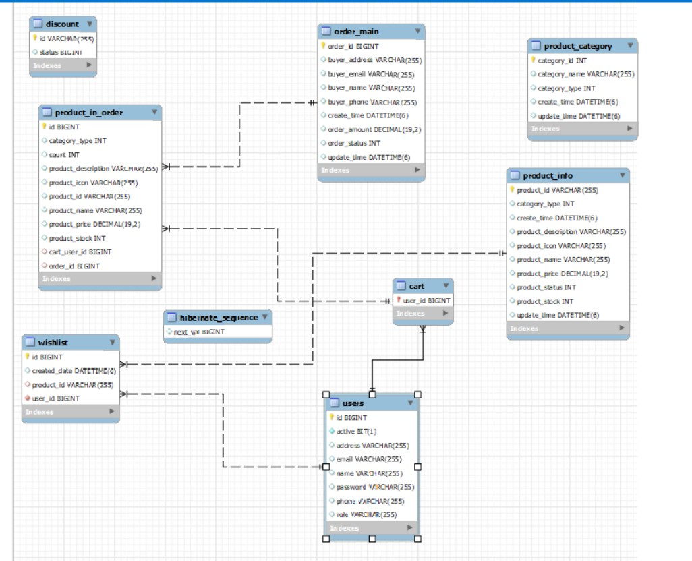
2 . Create database schema (all tables along with their relationships)

Slide 6
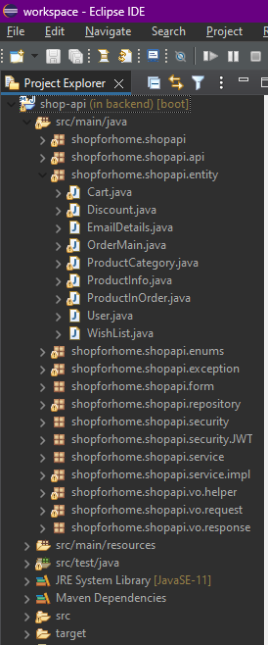
3. Create entities in Spring

Slide 7
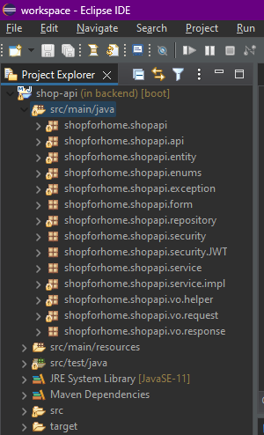
4. Create Microservice based structure

Slide 8
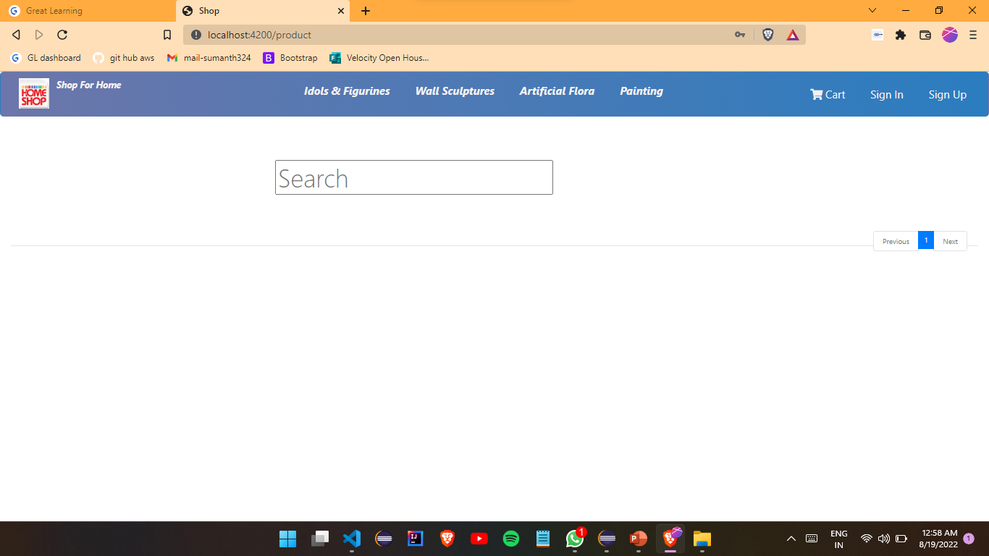
6. Create an e-commerce Template in Angular (Static only) to hold images and products lists.
Fig- homepage

Slide 9
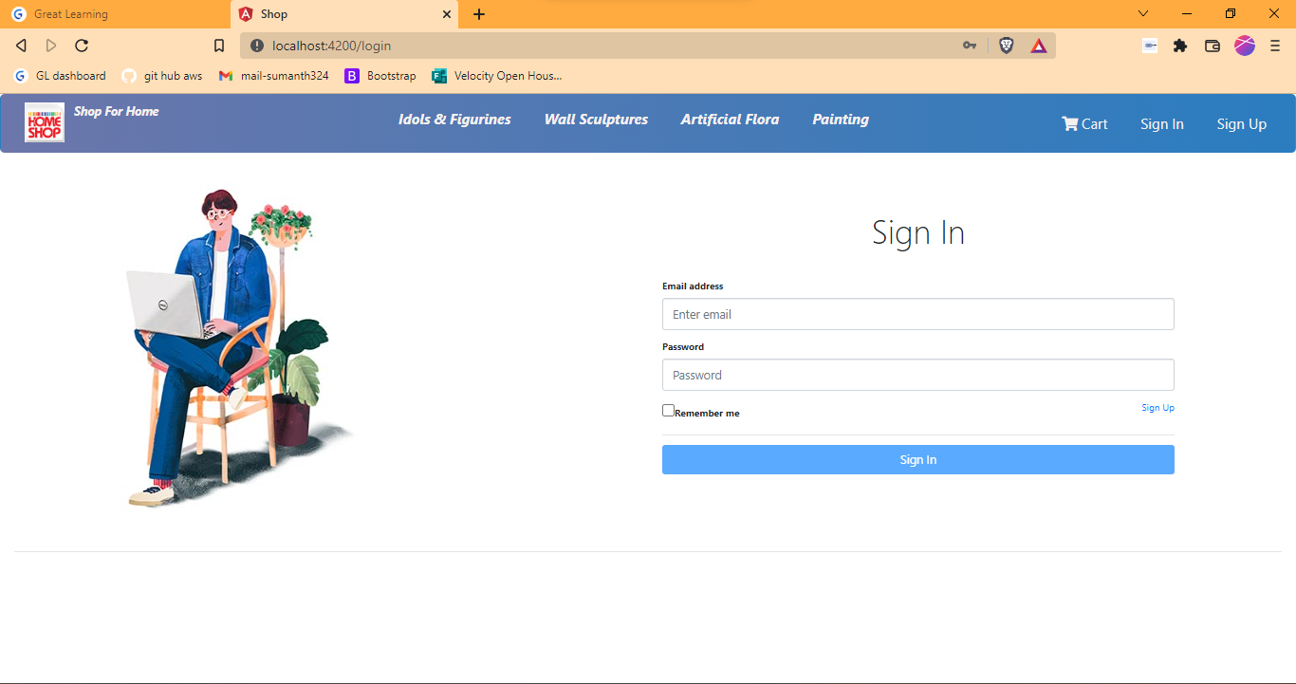
Fig- sign in page

Slide 10
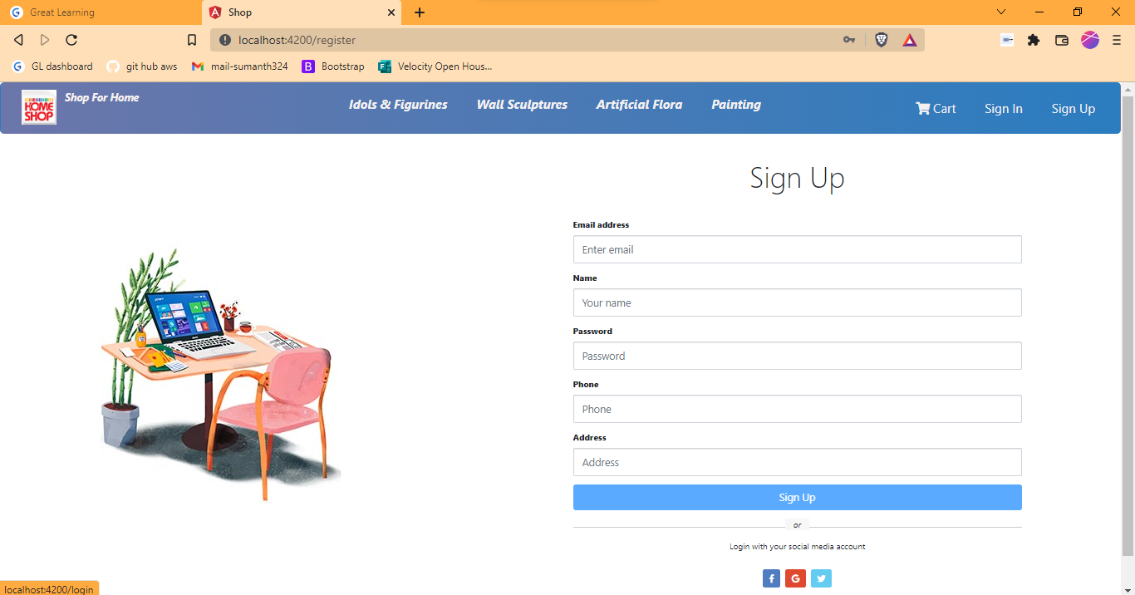
Fig- sign up page

Slide 11
Thank you

